Slide 1
Final Research Report
William Skamser

Slide 2
Research Project Goal and Approach
The goal of this project was to use GMAT (General Mission Analysis Tool) to validate low-thrust orbital trajectories.
Unfortunately, GMAT does not have a built-in method to solve low-thrust problems.
Two approaches were pursued:
Use GMAT’s API to run scripts through an exterior optimization algorithm (SNOPT). And develop a tool to automate this process.
Acquire CSALT (Collection Stand-Alone Library and Tool) GMAT plugin

Slide 3
Development of GMAT Low-Thrust Solving Function
Using GMAT’s Matlab API and SNOPT’s Matlab interface, a function was developed that was capable of propagating and optimizing low-thrust trajectories.
The function reads data from a setup Excel file and auto-generates a GMAT script to propagate low-thrust trajectories.
Able to propagate any low-thrust trajectory.
The function can be prompted to optimize the trajectory to meet constraints or minimize the time of flight while meeting constraints.
Can optimize any continuous, constant magnitude, low-thrust trajectory.

Slide 4
How the function works
Reads initial guess and setup data from Excel file
Creates GMAT Script that can propagate Low-Thrust trajectory
Enter SNOPT optimization loop
Uses the in-plane and out-of-plane thrust angles and time of flight as design variables
Updates GMAT thrust trajectory file and rerun GMAT script
Extract the satellite’s final state vector as constraint function
Continue the loop until feasibility and optimality tolerance are achieved
Long run time due to saving files and rerunning GMAT script for every iteration

Slide 5
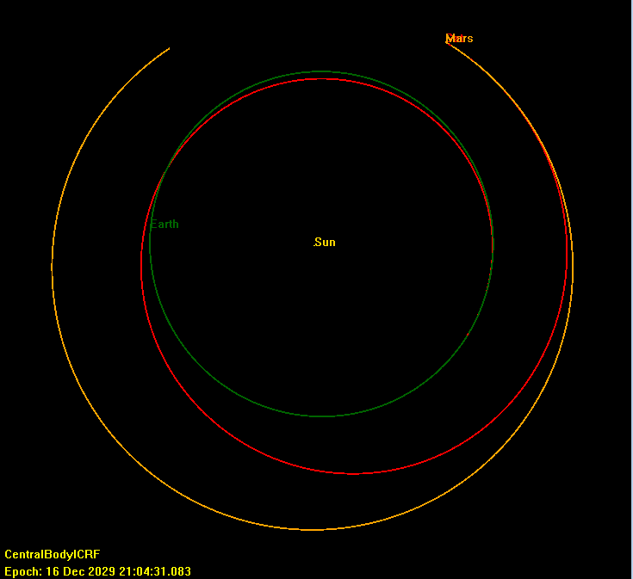
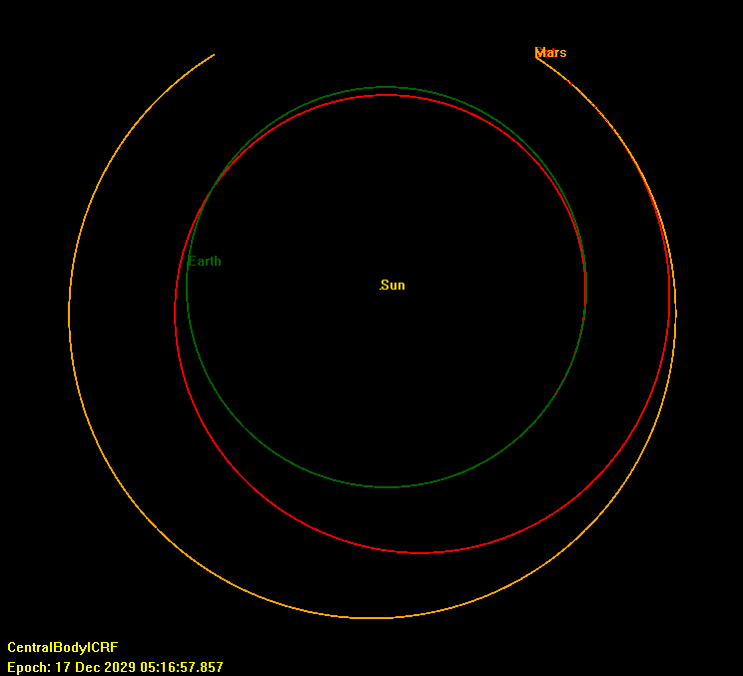
Method to Reduce Optimization Run Time
Reducing number of steps
200 Steps
16 Hours
10 Steps
17 Minutes

Slide 6
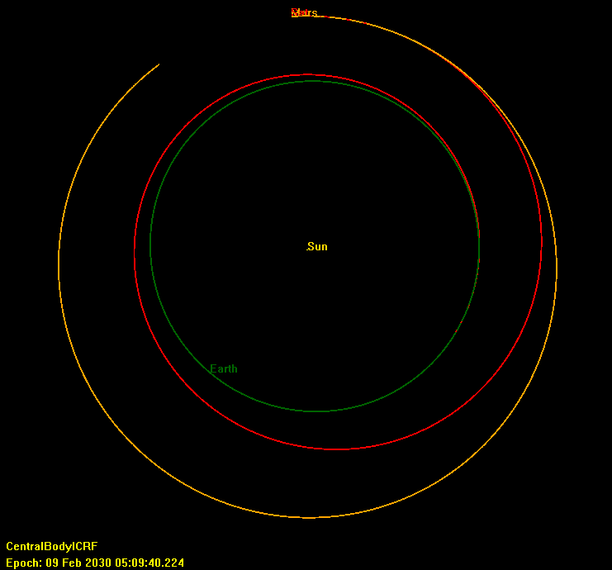
Method to Reduce Optimization Run Time
2) First optimize to meet constraints then optimize for time of flight
10 Steps
9 Minutes
10 Steps
8 Minutes

Slide 7
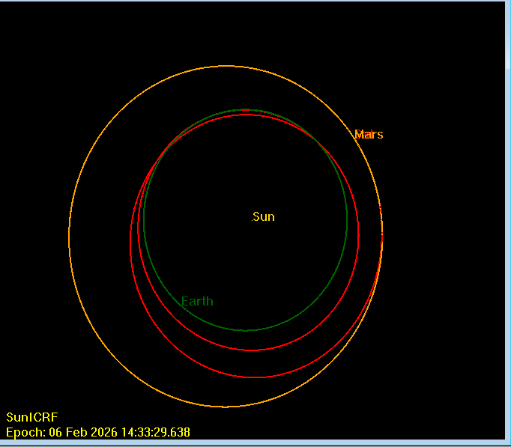
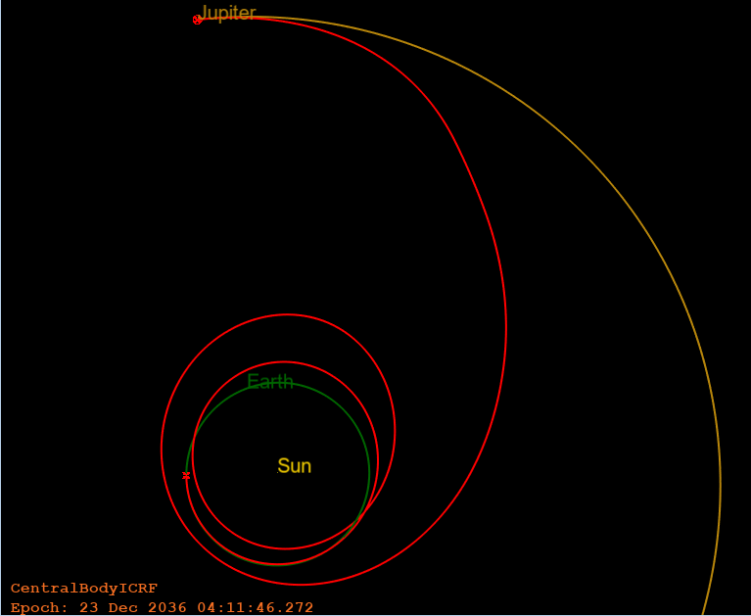
Other Examples
200 Steps
300 Steps
Earth to Jupiter Solution
Earth to Mars Solution used in Conference Paper Link

Slide 8
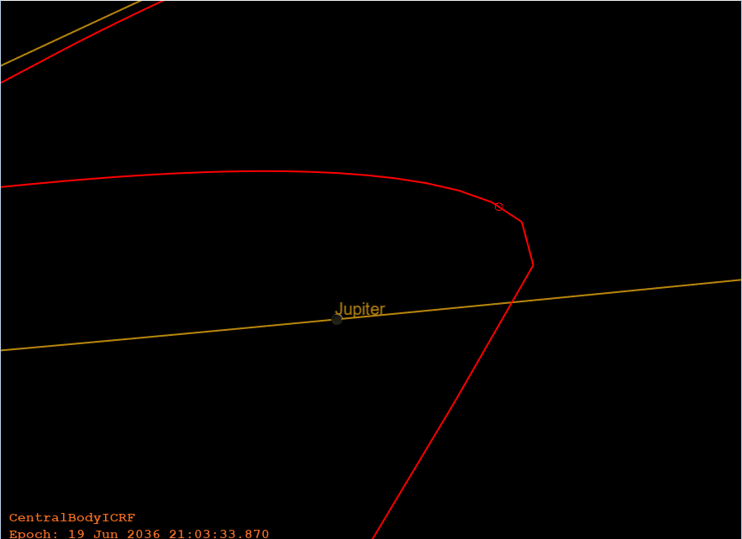
Potential to do flybys (with additional work to function)
Matlab Function already has an option for planetary force models
Would need a smaller step size in GMAT’s integrator
Even longer run times

Slide 9
Acquiring CSALT Plugin
CSALT is an optimal control solver that can be used in GMAT to solve Low-Thrust Trajectories. Link
The compiling process for the software is not well documented
Python Configure script and CMAKE require changes to get them to work
Was able to get to step 3 in the compiling process and document the changes I made to the Configure script
Recommend future student pursue this approach as runtime can’t be further reduced in the first approach

